Slide 1

INSTITUTE UIE
DEPARTMENT ACADEMIC UNIT-1
Bachelor of Engineering (Computer Science & Engineering)
Subject Name Semi Conductor Physics
Subject Code 23SPH-143
Prepared By
Navjeet Kaur
Experiment-3.2.2
Power Supply LPS, SMPS.
DISCOVER . LEARN . EMPOWER

Slide 2
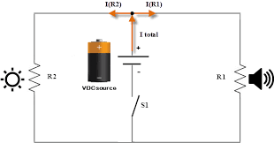
Lecture Objectives
S. No. | Objectives
1 | To make student aware about power supply
2 | To aware about need of filters used in power supply
3 | To provide knowledge about difference between LPS and SMPS
4 | To aware about types of SMPS
5 | To give various applications of SMPS
https://library.automationdirect.com/basic-electrical-theory/

Slide 3
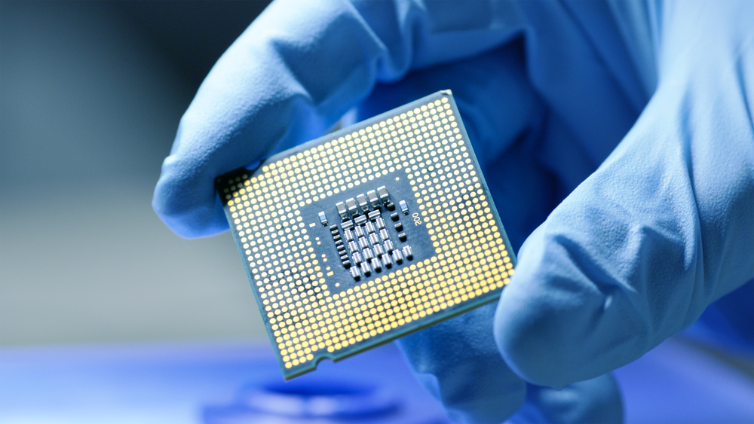
Course Objectives
S. No. | Objectives
1 | To understand the basic materials and properties of semiconductors.
2 | Understand the basic of semiconductor and components like diode, transistor, FET, MOSFET and Energy Sources.
3 | To give knowledge about semiconductor physics and discus working and applications of basic devices, including p-n junctions, BJTs and FETs.
https://www.iqsdirectory.com/resources/everything-you-ever-wanted-to-know-about-semiconductors/

Slide 4
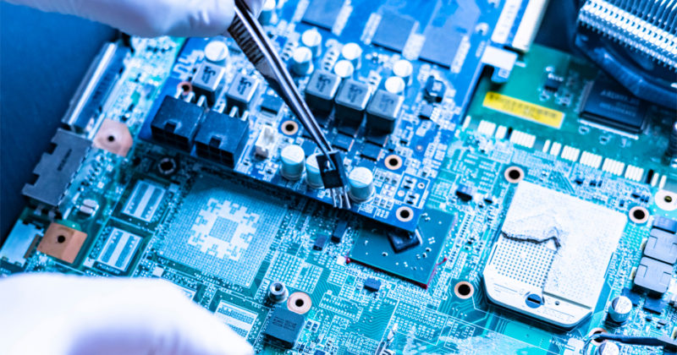
Course Outcomes
S.NO | Description | Blooms’ Taxonomy Level
CO1 | To apply the knowledge of basic semiconductor material physics and understand fabrication processes. | EASY
CO2 | To understand the characteristics of different electronic devices such as diodes, transistors. | MEDIUM
CO3 | To derive the relationships between the parameters in diode, FET, configurations of Transistor and MOSFETs. | MEDIUM
CO4 | To describe the working and design considerations for the various photonic devices like photo detectors, solar-cells and LEDs. | HARD
CO5 | To provide problem solving experience and learning of concepts through it in semiconductor physics. | HARD
https://lot.dhl.com/5-things-the-current-semiconductor-slowdown-tells-us-about-the-global-economy/

Slide 5
CONTENTS
Introduction to linear power supply
Block diagram of linear power supply
Working of linear power supply
Concept of switched mode power supply
Requirements of SMPS
Block diagram of switched mode power supply
Working of switched mode power supply
Types of SMPS
Applications of switched mode power supply

Slide 6
INTRODUCTION TO POWER SUPPLY
The electric power is not normally used in the form in which it is produced or distributed.
Practically all electronic systems require some form of Power conversion.
A device that transfers electric energy from a source to a load using electronic circuits is referred to as power supply.
A typical application of a power supply is to convert utility AC voltage into regulated DC voltages required for electronic equipment.

Slide 7
CATEGORIES OF POWER SUPPLIES
There are two broad categories of power supplies:
Linear regulated power supply
Switched mode power supply (SMPS) in some cases one may use a combination of switched mode and linear power supplies to gain some desired advantages of both the types.

Slide 8
INTRODUCTION TO LINEAR/REGULATED POWER SUPPLY
A linear power supply typically uses a large transformer to drop voltage from an AC line to a much lower AC voltage, and then uses a series of rectifier circuitry and filtering process to produce a very clean DC voltage.
Linear regulated power supplies gain their name from the fact that they use linear, i.e. non-switching techniques to regulate the voltage output from the power supply.
The term linear power supply implies that the power supply is regulated to provide the correct voltage at the output.

Slide 9
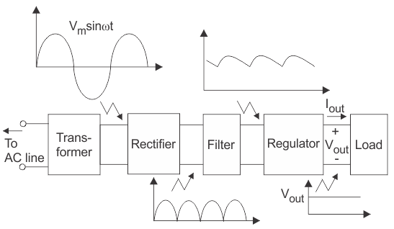
BLOCK DIAGRAM OF LINEAR/REGULATED POWER SUPPLY
The voltage is sensed and this signal is fed back, normally into some form of differential amplifier where it is compared with a reference voltage and resulting signal is used to ensure the output remains on the required voltage.
Fig.1 Block diagram of linear power supply
https://www.electrical4u.com/regulated-power-supply/

Slide 10
DESCRIPTION OF BLOCK DIAGRAM
The AC voltage is connected to a transformer, which steps that ac voltage down to the level for the desired dc output.
A diode rectifier then provides a full-wave rectified voltage.
This is initially filtered by a simple capacitor filter to produce a dc voltage.
This resulting dc voltage usually has some ripple or ac voltage regulation.
A regulator circuit can use this dc input to provide a dc voltage that not only has much less ripple voltage but also remains the same dc value even if the input dc voltage varies somewhat or the load connected to the output dc voltage changes.
This voltage regulation is usually obtained using one of the voltage regulator IC units.

Slide 11
TRANSFORMER
A power supply can be used for providing the necessary amount of power at the precise voltage from the main source like a battery.
A transformer alters the AC mains voltage toward a necessary value and the main function of this is to step up and step down the voltage.
For instance, a step-down transformer is used in a transistor radio, and a step-up transformer is used in a CRT.
Transformer gives separation from the power-line, and must be used even as any modify within voltage is not required.

Slide 12
RECTIFIER
A rectifier is an electrical device used to convert alternating current into direct current.
It can be a full wave rectifier as well as half wave rectifier with the help of a transformer by a bridge rectifier otherwise center tapped secondary winding. However, the rectifier’s o/p can be variable.

Slide 13
CAPACITOR FILTER
Smoothing is not perfect due to the capacitor falling a little as it discharges, giving a small ripple voltage.
For many circuits a ripple which is 10% of the supply voltage is satisfactory & the equation below gives the required value of the smoothing capacitor.
A large capacitor has less ripple.
Capacitor value must be doubled when smoothing half-wave DC.

Slide 14
REGULATOR
Regulator eliminates ripple by setting DC output to a fixed voltage.
Voltage regulator IC’s are available with fixed (typically 5,12 &15V) or variable output voltages.
They are also rated by the maximum current that they can pass.
Negative voltage regulators are available mainly for use in dual supplies.
A voltage regulator in the regulated power supply is essential for keeping a steady DC output voltage by supplying load regulation as well as line regulation.

Slide 15
APPLICATIONS OF LINEAR POWER SUPPLY
Mobile phone chargers.
Regulated power supplies in different appliances.
Various oscillators & amplifiers.

Slide 16
SWITCHED MODE POWER SUPPLY
Switch Mode Power Supplies, or SMPS, are becoming common place and have replaced in most cases the traditional linear ac-to-dc power supplies as a way to cut power consumption, reduce heat dissipation, as well as size and weight.
By definition, a switch mode power supply (SMPS) is a type of power supply that uses semiconductor switching techniques, rather than standard linear methods to provide the required output voltage.
The basic switching converter consists of a power switching stage and a control circuit.

Slide 17
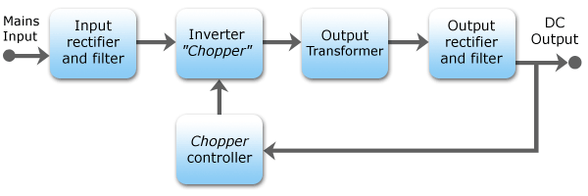
BLOCK DIAGRAM OF SWITCHED MODE POWER SUPPLY
The power switching stage performs the power conversion from the circuits input voltage, VIN to its output voltage, VOUT which includes output filtering.
Fig.2 Block diagram of witched mode power supply
https://en.wikipedia.org/wiki/Switched-mode_power_supply

Slide 18
REQUIREMENTS OF SMPS
Less bulky transformers.
Less Energy loss / eddy currents.
Capacitors of small size.

Slide 19
WORKING OF SWITCHED MODE POWER SUPPLY
The input supply drawn from ac mains is first rectified & filtered using a capacitor.
The unregulated dc voltage across the capacitor is then fed to a high frequency dc- to dc converter.
Input Stage
The AC input supply signal 50 Hz is given directly to the rectifier and filter circuit combination without using any transformer.
This output will have many variations and the capacitance value of the capacitor should be higher to handle the input fluctuations. This unregulated dc is given to the central switching section of SMPS.

Slide 20
WORKING OF SWITCHED MODE POWER SUPPLY
Switching Section
A fast switching device such as a Power transistor or a MOSFET is employed in this section, which switches ON and OFF according to the variations and this output is given to the primary of the transformer present in this section.
The transformer used here are much smaller and lighter ones unlike the ones used for 60 Hz supply.
These are much efficient and hence the power conversion ratio is higher.

Slide 21
WORKING OF SWITCHED MODE POWER SUPPLY
Output Stage
The output signal from the switching section is again rectified and filtered, to get the required DC voltage.
This is a regulated output voltage which is then given to the control circuit, which is a feedback circuit.
The final output is obtained after considering the feedback signal.

Slide 22
WORKING OF SWITCHED MODE POWER SUPPLY
Chopper Controller/ Control unit
The output sensor senses the signal and joins it to the control unit.
The signal is isolated from the other section so that any sudden spikes should not affect the circuitry.
A reference voltage is given as one input along with the signal to the error amplifier which is a comparator that compares the signal with the required signal level.

Slide 23
INPUT RECTIFIER
The first stage is to convert AC input to DC output (Rectification).
The rectifier produces an unregulated DC voltage which is sent to a large filter capacitor.
The current drawn from the mains supply by this rectifier circuit occurs in short pulses around the AC voltage peaks.
These pulses have significant high frequency energy which reduces the power factor.
Special control techniques can be employed by the following SMPS to force the average input current to follow the sinusoidal shape of the AC input voltage thus the designer should try correcting the power factor.

Slide 24
INVERTER
This converts DC, Whether directly from the input or from the rectifier, to AC by running it through a power oscillator, whose output transformer is very small with few windings at a frequency of tens or hundreds of kHz.
The frequency is usually chosen to be above 20 kHZ, to make it inaudible to humans.

Slide 25
OUTPUT TRANSFORMER
If the output is required to be isolated from input, (as is usually the case in mains power supplies) the inverted AC is used to drive the primary winding of a high frequency transformer.
This converts the voltage up or down to the required output level on its secondary winding.

Slide 26
OUTPUT RECTIFIER & FILTER
If a DC output is required, the AC output from the transformer is rectified.
For output voltages above ten volts or so, ordinary silicon diodes are commonly used.
For lower voltages schottky diodes are commonly used as rectifier elements (they have faster times than silicon diodes, thus allowing low-loss operation at higher frequencies).
The rectified output is then smoothed by a filter consisting of inductors & capacitors.
For higher switching frequencies, components with lower capacitance & inductance are needed. .

Slide 27
APPLICATION OF SMPS
Isolation of patients in diagnostic instruments like ECG etc. (using optocouplers in control circuitry)
SMPS battery chargers for battery based instruments.
Motherboard of computers
Mobile phone chargers
HVDC measurements
Battery chargers
Central power distribution
Laptops

Slide 28
FREQUENTLY ASKED QUESTIONS
Define battery in your own terms.
Differentiate between primary & secondary cells?
What are various applications of battery?
What do you mean by SMPS?

Slide 29
Practice Questions
What are the different types of power supply?
Explain the block diagram of SMPS.
Discuss the applications of linear power supply.
Explain cut off voltage and nominal capacity.
Notes:
29

Slide 30

LEARNING OUTCOMES
To make students understand
Operation of SMPS.
Different types of Power supply.
Concept of linear power supply.
Different terminologies used in battery.

Slide 31
REFERENCES
Books: [1]Basic of Electrical Engineering, T. K. Nagsarkar and M. S.Sukhija,2013 ,2nd edition
[2]Theory and problems of Basic Electrical Engineering, J. Nagrath and Kothari, 2012, 2nd edition
[3] A Textbook of Electrical Technology, B.L Theraja,2010,Vol 1
[4] Fundamentals of Electrical and Electronics Engineering, Smarjith Ghosh,2013,1st edition
E-Books: [1]https://www.google.co.in/search?tbo=p&tbm=bks&q=inauthor:%22A.V.Bak shi+U.A.Bakshi%22
[2] https://www.pdfdrive.com/a-textbook-of-electrical-technology-volume-i- basic-electrical-engineering-
e31735088.html
Websites: [1] https://nptel.ac.in/content/storage2/courses/121106014/Week12/lecture38.pdf
[2] https://www.cedengineering.com/userfiles/Introduction%20to%20Batteries.pdf
[3] http://web.mit.edu/evt/summary_battery_specifications.pdf
[4] https://shodhganga.inflibnet.ac.in/bitstream/10603/1303/7/07_chapter%201.pdf
Videos: [1] https://youtu.be/gWKOjncBMCQ
[2] https://youtu.be/PXNKkcB0pI4

Slide 32
THANK YOU
For queries
Email: kanchanbharti.ee@cumail.in

